Slide 1

Drupal Camp – Automating Drupal Deployment

Slide 2
Domidc & Dropsolid
Dropsolid
Solutions – Consultancy – Training
Founded in januari 2013
2 business developers – 2 technical project managers and 6 drupal developers
Dominique De Cooman
Drupal developer since 2007
Experience leading teams since 2011
One of the founders of Dropsolid
Responsible for service and product development and delivery

Slide 3
Follow allong
Check this url on my blog to follow along
http://dominiquedecooman.com/drupalcampAE
There is more than this slides can hold.

Slide 4
Why deploying automaticaly
Faster
Less errors
Well documented
Reproducable
History
Continous Integration

Slide 5
Basic components
Vps with a Lamp stack
Version control – Git
Drush
Drupal of course
Dev – Staging – Production setup
Continous integration server
Deployment scripts

Slide 6
How to set it up?
Vps
You can get a vps from 12€/month on most hosting platforms. There are trials available everywhere
Example:
https://www.gandi.net/hosting/trial/
https://control.vps.net/trial-signup

Slide 7
Install your lamp stack
Plenty of installation scripts online
Example
http://www.dominiquedecooman.com/blog/automate-installing-drupal-ubuntu-drupal-training-purpose

Slide 8
Version control
Git
We will use the succesfull branching model
http://nvie.com/posts/a-successful-git-branching-model/
Git flow
Production branch
Development branch
Release branch
Hotfixes
Install
Git flow
Bash complete

Slide 9
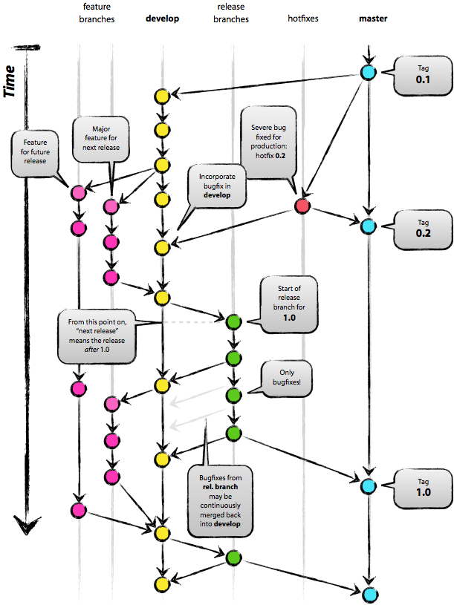
Git flow

Slide 10
Drush
DRUpal SHell
Install
http://drupal.org/project/drush
Drush aliasses
Simplyfies executing commands in builds

Slide 11
Drupal
Create a proper repository layout
Bash
Updates
Installs
scripts
Docroot
Documentation
Etc
Drupal (settings files, robot.txt, htaccess, …)
Drush - aliases
Ssh
vhost
Configure you server to connect to drupal.

Slide 12
Continuous integration server
Jenkins
Install
https://wiki.jenkins-ci.org/display/JENKINS/Installing+Jenkins+on+Ubuntu
Why?
Automate our workflow
Execute our tests

Slide 13
Automating the workflow
Exporting database changes
Configuring jenkins jobs
Writing deployment scripts

Slide 14
Exporting database changes
Use features
Use hook_update()
D8 configuration management in core

Slide 15
Configuring jobs
Jenkins
Create jobs
Environments
Testbots
Basic setup
General settings
Repository configuration
Build triggers
Post build actions

Slide 16
Build section
Copy files
Update the code
Settings file
Copy build script

Slide 17
Deploy scripts
Enable/Disable ui modules
Set environment specific variables
Error_level
Cache
Revert features
Update the database
Flush cache

Slide 18
Differences per environment
Modules
Leave the opportunity to debug
Error level
Caching settings
Staging and production must by identical
Representative
No testrun on production

Slide 19
Demo
Simulation of development

Slide 20
Resources
Minimizing overhead with git flow http://dominiquedecooman.com/blog/git-flow-minimizing-overhead
Installing lamp stack http://www.dominiquedecooman.com/blog/automate-installing-drupal-ubuntu-drupal-training-purpose
Go live checklist http://www.dominiquedecooman.com/blog/drupal-7-tip-how-automate-and-control-your-go-live-checklist
Install jenkins https://wiki.jenkins-ci.org/display/JENKINS/Installing+Jenkins+on+Ubuntu
https://www.gandi.net/hosting/trial/
Get all the code, job scripts and presentation overview: http://dominiquedecooman.com/blog/automating-drupal-deployment

Slide 21
Questions?
Questions?
Review at: http://dominiquedecooman.com/blog/drupalcamp-pakistan-automating-drupal-deployment
http://dropsolid.com
http://dominiquedecooman.com
Twitter: dominiquedc
Drupal: http://drupal.org/user/199987

